Slide 1


CRM Application for Jewel Management-(Developer)
TEAM LEADER:
Vanasofy A (912422104054 )
TEAM MEMBERS:
Swetha S (912422104049)
Swetha SM (912422104050),
Swetha T (912422104051)
COLLEGE NAME:
Shanmuganathan E ngineering College

Slide 2
PROJECT OVERVIEW
A cloud-based CRM system built using Salesforce to manage jewelry business operations.
Integrates customers, items, prices, and billing under one platform.
Automates workflows using tools like Object Manager, App Builder, and Flow Builder.
Aims to replace manual processes with efficient, accurate, and scalable digital solutions.

Slide 3
OBJECTIVES
Automate jewelry business operations.
Maintain data accuracy and consistency.
Utilize Salesforce declarative tools (no coding).
Improve accessibility and business efficiency.
Provide a secure, cloud-based CRM platform.

Slide 4
TECHNOLOGIES USED
Salesforce Lightning Platform
Object Manager, Schema Builder
Flow Builder, App Builder
Reports & Dashboards
Profiles, Roles, Permission Sets

Slide 5
SYSTEM DESIGN
Architecture Layers:
  UI Layer: Lightning App and Tabs for users.
  Application Layer: Declarative tools handle logic.
  Database Layer: Cloud-based Salesforce storage.
Data Flow:
  Customer → Item → Price → Billing → Reports
  Automated updates via record-triggered flows.

Slide 6
SYSTEM MODULES
Setup & Configuration: Objects, Fields, Tabs, Layouts.
Security & Access Control: Profiles, Roles, Permission Sets.
Reporting & Analytics: Reports and Dashboards.
Automation & Process: Record-Triggered Flows.
User Management: User Accounts and Adoption Tracking.

Slide 7
WORKFLOW OVERVIEW
Add customer details to Jewel Customer Object.
Add items and link them to customers.
Define prices in the Price Object.
Billing auto-generated through Flow Builder.
Data visualized in Reports and Dashboards.

Slide 8
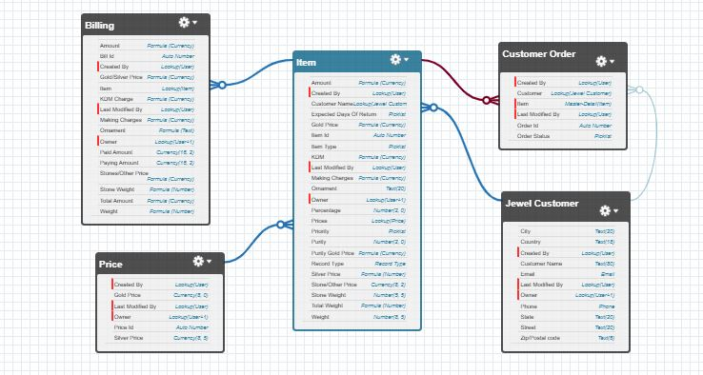
WORKFLOW DIAGRAM

Slide 9
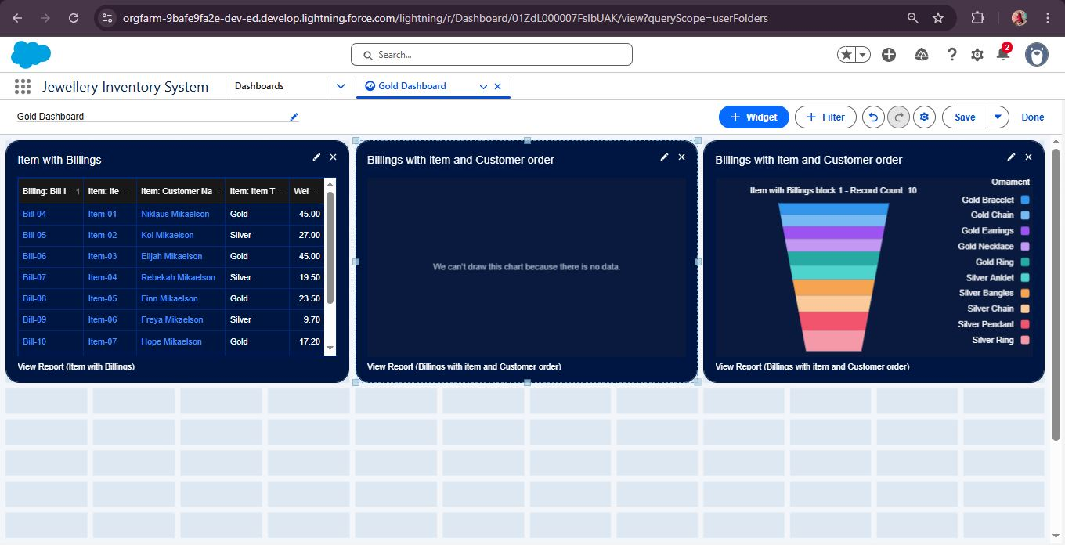
DASHBOARD OUTPUT

Slide 10
OUTCOMES & FUTURE ENHANCEMENTS
Expected Outcomes:
Efficient data handling and automation.
Real-time analytics and reports.
Reduced manual workload.
Future Enhancements:
Mobile app and AI-based jewelry suggestions.
Loyalty and reward system.
Integration with payment gateways and chatbot support.

Slide 11
CONCLUSION
The CRM Application for Jewel Management provides a modern and efficient solution for jewelry business operations.
It automates core tasks, ensures data accuracy, and enhances customer experience.
With its scalable Salesforce architecture, it simplifies management and decision-making.
Future enhancements like AI, mobile integration, and payment automation can further strengthen business growth.

